Slide 1
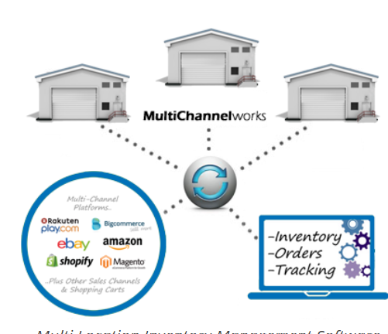
Amazon Sales Dashboard: Understanding Branch Performance

Slide 2
Slide 1: Product Analysis
- Overview of product line performance.
- Highlight top-performing product lines and areas for improvement.
- Insights on sales trends and profitability across different product categories

Slide 3
Slide 2: Sales Analysis
- Analysis of sales trends over time.
- Evaluation of sales strategies' effectiveness.
- Recommendations for modifications to enhance sales performance.

Slide 4
Slide 3: Customer Analysis
- Identification of different customer segments and their purchasing trends.
- Assessment of customer profitability.
- Insights into customer behavior and preferences.

Slide 5
Slide 4: Insights, Recommendations, and Summaries
- Summary of key insights from the analysis.
- Recommendations for actionable strategies based on the findings.
- Highlight of significant trends and areas of focus for future improvement.

Slide 6

thank you

